Slide 1
Guillain-Barre syndrome

Slide 2
Outline
Background
Epidemiology
Classification
Signs and symptoms
Pathophysiology
Diagnosis
Treatment
Conclusion
References

Slide 3
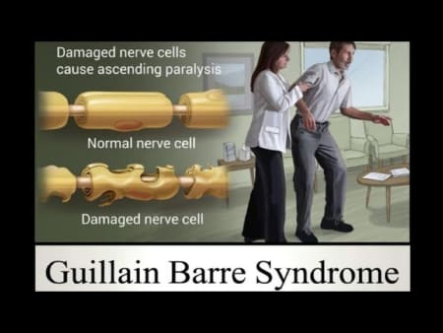
Background
Guillain-Barre syndrome (GBS) is a rare disorder resulting from a damage to the peripheral nervous system by the immune system.
The condition was first described in 1859 by Jean-Baptiste Octave Landry a French physician (Landry, 1859).
In 1916, two French neurologists, which GBS was named after, Georges Guillain and Jean Alexandre Barré with a French physician André Strohl diagnosed two soldiers and described the main diagnostic abnormalities (van Doorn et al., 2008).
An infection or other immune stimulation that induces an aberrant autoimmune response targeting peripheral nerves and their spinal roots precedes GBS.
Figure 1: Guillain-Barré syndrome (copyright lybrate)

Slide 4
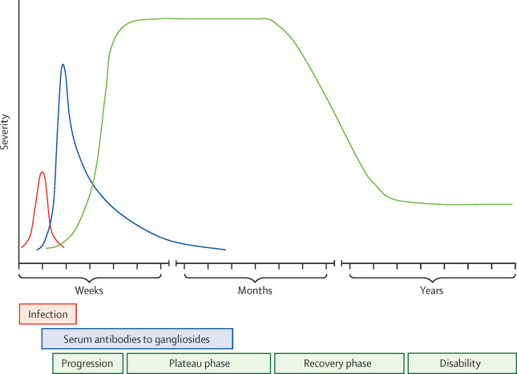
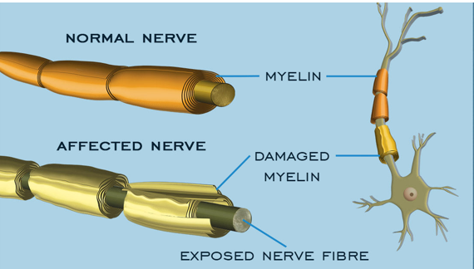
Figure 2: Guillain-Barré syndrome time course (Hugh et al., 2016)
Figure 3: copyright MASS4D

Slide 5
Epidemiology
Studies in Europe and America have reported similar cases of GBS to be about 0.89 to 1.89 cases per 100,000 people per year (Sejvar et al., 2011).
The risk of the disorder increases with age which is less likely to affect children (0·6 per 100 000 per year) compared to the elderly aged years and over (2·7 per 100 000 per year) (Hugh et al., 2016; Sejvar et al., 2011)
The relative risk of GBS in men compared to women is 1.78 putting them at higher risk of the disorder (Sejvar et al., 2011; Yuki and Hartung, 2012).
Reports have shown that most GBS outbreak is as a result of C jejuni infections (Jackson et al., 2014).
The demyelinating subtype of GBS is common (about 60–80%) in Europe and United states while Acute motor axonal neuropathy (AMAN) subtype is higher in Asia and Central and south America (van den Berg et al., 2014).

Slide 6
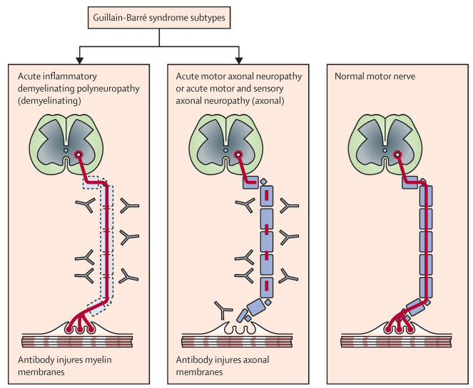
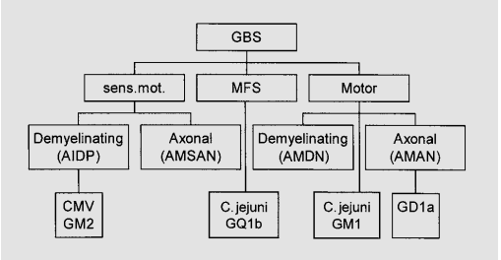
Classification
Figure 4: Steps in classifying clinically defined GBS (Van der Meché et al., 2001)
Figure 5: Major Guillain-Barré syndrome subtypes (Hugh et al., 2016)

Slide 7
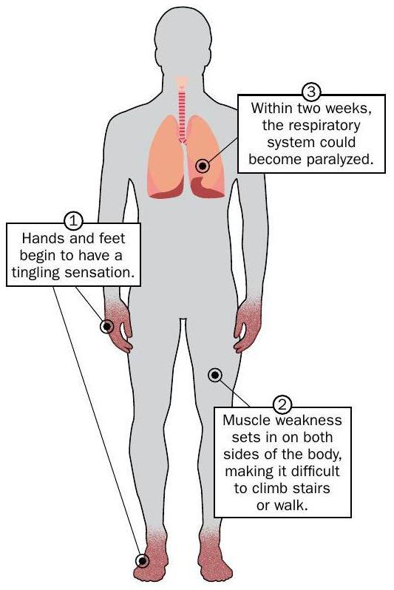
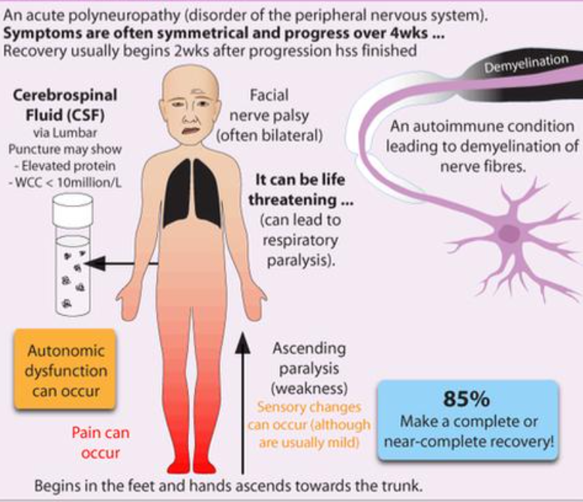
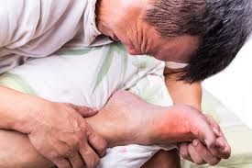
Signs and symptoms
Figure 6: photo credit: Marler Clark
Figure 8: copyright Grepmed
Figure 7: photo credit: Marler Clark

Slide 8
Signs and symptoms contd
Progressive weakness in legs and arms (sometimes initially only in legs).
Areflexia (or decreased tendon reflexes) in weak limbs.
Progressive phase lasts days to 4 weeks (often 2 weeks).
Mild sensory symptoms or signs (not present in acute motor axonal neuropathy).
Cranial nerve involvement 30-40% of cases, especially bilateral weakness of facial muscles .
Autonomic dysfunction.
Pain (common).
Hugh et al., 2016

Slide 9
pathophysiology
C. jejuni lipooligosacharides (LOS) and lipopolysaccharides (LPS) display molecular mimicry with gangliosides and production of antibodies against these structures induces a cross-reactive immune response to nerve structures, triggering autoimmunity and neural damage (Godschalk, et al., 2004; Yuki, 2007).
Gangliosides attacked by the immune system are located as follows: GM1, GD1a and GM1/GD1 complex situated at the terminal nerves and anterior roots, closely related to AIDP and AMAN (Godschalk, et al., 2004).
GQ1b is located on oculomotor nerves (that is, III, IV and VI) and primary sensory neurons, and is correlated with Miller Fisher syndrome (MFS) (Yuki, 2007).

Slide 10
pathophysiology
ANTIBODY | TARGET
Anti-GD1a | Paranadol myelin, nodes of Ranvier, and neuromuscular junction (Chiba et al., 1993; Goodfellow et al., 2005).
GM1 and GQ1B | Peripheral nerve or neuromuscular junction (Willison et al., 1997; Greenshields et al., 2009).
ANTIBODY | PRESENTATION
Anti-GQ1B | Miller-Fisher syndrome (Chiba et al., 1992)
Anti-GM1 | The axonal motor neuropathy (Gregson et al., 1991).
Anti-GT1A | The pharyngeal-cervical-brachial variant (O'Leary et al., 1996).
Table 1: Gangliosides antibodies and target
Table 2: Gangliosides antibodies and associated presentation

Slide 11
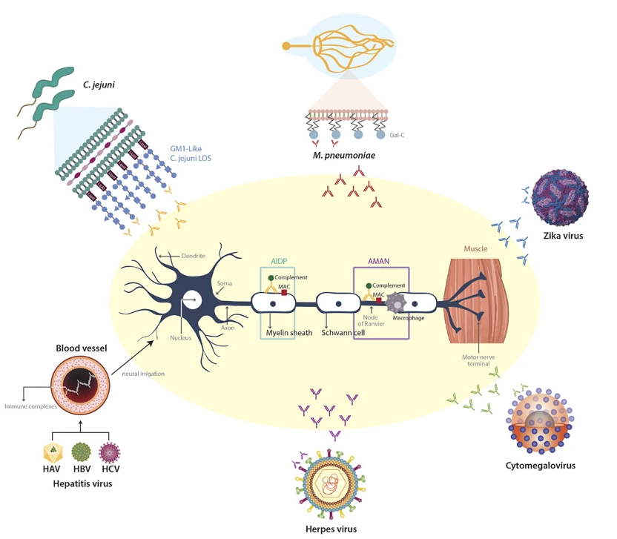
Figure 9: Pathogenesis of post-infectious Guillain-Barré syndrome (Rodríguez, et al., 2018). GM1, monosialotetrahexosylganglioside; LOS, lipooligosacharide; Gal-C, Galactocerebroside; MAC, membrane-attack complex.

Slide 12
Diagnosis
Guillain-Barré syndrome is diagnosed by the combination of clinical presentation, Cerebrospinal fluid (CSF), electromyography and nerve conduction studies.
CSF abnormalities are characterised by increased protein without pleocytosis, which is a non-specific finding, seen in many of the conditions which mimic GBS on imaging and clinically.
Nerve conduction abnormalities include slow or blocked nerve conduction, absent or prolonged H-reflexes and/or F-wave latencies (Chanson et al., 2014; Albertí et al., 2011).
Imaging such as Magnetic resonance imaging (MRI)
Negative inspiratory force (NIF) should be performed on patients with suspected GBS

Slide 13
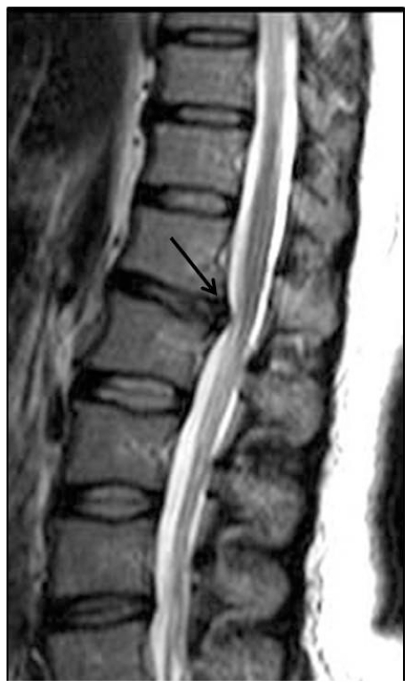
MRI of GBS
Figure 10: 39 year-old female with Guillain-Barré syndrome secondary to systemic lupus erythematosus. She presented with progressive bilateral lower extremity weakness. Sagittal TSE T2-weighted MR image demonstrates disc herniation at T12-L1 level (arrow). The herniated disc is seen to cause minimally conus medullaris compression (Alkan at al., 2009).

Slide 14
Treatment
Two main treatment types are available, with several factors like socioeconomic factors and patients are to be considered in the treatment of GBS
Plasma exchange, given as a volume exchanger over five seasons, acts by removing pathogenic antibodies, humoral mediators, and complement proteins involved in the pathogenesis of GBS, requires equipment and difficult to perform in children and patients with autonomic cardiovascular instability (Raphaël et al., 2012).
Intravenous immunoglobulin (IVIG), is given in 2g/kg body weight divided over 5 days, acts via immune-modulation and is effective in patients who are unable to walk 10 m unaided (Ortiz-Salas et al., 2016).

Slide 15
Conclusion
Guillain-Barre syndrome (GBS) is a rare auto immune disorder that affects the peripheral nervous system with less than 2 cases per 100,000 people per year. It is mostly preceded by an infection which eventually causes mimicry of gangliosides. It causes pain, symmetric, progressive and ascending paralysis of the extremities. GBS can be treated by either plasma exchange or Intravenous immunoglobulin.

Slide 16
References
Albertí, M.A., Alentorn, A., Martínez-Yelamos, S., Martínez-Matos, J.A., Povedano, M., Montero, J., Casasnovas, C. (2011) Very early electrodiagnostic findings in Guillain-Barré syndrome. J Peripher Nerv Syst, 16(2): pp.136-142.
Alkan, O., Yildirim, T., Tokmak, N., and Tan, M. (2009) Spinal MRI findings of guillain-barré syndrome. Journal of radiology case reports, 3(3), 25–28.
Chanson, J.B., Echaniz-Laguna, A. (2014) Early electrodiagnostic abnormalities in acute inflammatory demyelinating polyneuropathy: a retrospective study of 58 patients. Clin Neurophysiol, 125(9), pp. 1900-1905.
Chiba, A., Kusunoki, S., Obata, H., Machinami, R., Kanazawa, I. (1993) Serum anti-GQ1b IgG antibody is associated with ophthalmoplegia in Miller Fisher syndrome and Guillain-Barré syndrome: clinical and immunohistochemical studies. Neurology, 43(10), pp. 1911-1917.
Chiba, A., Kusunoki, S., Shimizu, T., Kanazawa, I. (1992) Serum IgG antibody to ganglioside GQ1b is a possible marker of Miller Fisher syndrome. Ann Neurol. (6), pp. 677-679.
Godschalk, P. C., Heikema, A. P., Gilbert, M., Komagamine, T., Ang, C. W., Glerum, J., Brochu, D., Li, J., Yuki, N., Jacobs, B. C., van Belkum, A., and Endtz, H. P. (2004) The crucial role of Campylobacter jejuni genes in anti-ganglioside antibody induction in Guillain-Barre syndrome. The Journal of clinical investigation, 114(11), pp. 1659–1665.
Goodfellow, J.A., Bowes, T., Sheikh, K., Odaka, M., Halstead, S.K., Humphreys, P.D., Wagner, E.R., Yuki, N., Furukawa, K., Furukawa, K., Plomp, J.J., Willison, H.J. (2005) Overexpression of GD1a ganglioside sensitizes motor nerve terminals to anti-GD1a antibody-mediated injury in a model of acute motor axonal neuropathy. J Neurosci, 25(7), pp. 1620-1628.
Greenshields, K.N., Halstead, S.K., Zitman, F.M., Rinaldi, S., Brennan, K.M., O'Leary, C., Chamberlain, L.H., Easton, A., Roxburgh, J., Pediani, J., Furukawa, K., Furukawa, K., Goodyear, C.S., Plomp, J.J., Willison, H.J. (2009) The neuropathic potential of anti-GM1 autoantibodies is regulated by the local glycolipid environment in mice. J Clin Invest, 119(3), pp. 595-610.
Gregson, N.A., Jones, D., Thomas, P.K., Willison, H.J. (1991) Acute motor neuropathy with antibodies to GM1 ganglioside. J Neurol. 238(8), pp. 447-451.
Hugh, J. W., Bart, C. J., and Pieter, A. v. (2016) Guillain-Barré syndrome. The Lancet, 388(10045), pp. 717-727.
Jackson, B. R., Zegarra, J. A., López-Gatell, H., Sejvar, J., Arzate, F., Waterman, S., Núñez, A. S., López, B., Weiss, J., Cruz, R. Q., Murrieta, D. Y., Luna-Gierke, R., Heiman, K., Vieira, A. R., Fitzgerald, C., Kwan, P., Zárate-Bermúdez, M., Talkington, D., Hill, V. R., Mahon, B., and GBS Outbreak Investigation Team (2014) Binational outbreak of Guillain-Barré syndrome associated with Campylobacter jejuni infection, Mexico and USA, 2011. Epidemiology and infection, 142(5), pp. 1089–1099.

Slide 17
Landry, J. (1859). "Note sur la paralysie ascendante aiguë". Gazette Hebdomadaire de Médecine et de Chirurgie. 6: pp. 472–474, 486–488.
O'Leary, C.P., Veitch, J., Durward, W.F., Thomas, A.M., Rees, J.H., Willison, H.J. (1996) Acute oropharyngeal palsy is associated with antibodies to GQ1b and GT1a gangliosides. J Neurol Neurosurg Psychiatry, 61(6): pp. 649-651.
Ortiz-Salas, P., Velez-Van-Meerbeke, A., Galvis-Gomez, C.A., Rodriguez, Q.J.H. (2016) Human Immunoglobulin Versus Plasmapheresis in Guillain-Barre Syndrome and Myasthenia Gravis: A Meta-Analysis. J Clin Neuromuscul Dis, 18(1), pp. 1-11.
Raphaël, J.C., Chevret, S., Hughes, R.A., Annane, D. (2012) Plasma exchange for Guillain-Barré syndrome. Cochrane Database Syst Rev. 11;(7):CD001798.
Rodríguez, Y., Rojas, M., Pacheco, Y., Acosta-Ampudia, Y., Ramírez-Santana, C., Monsalve, D. M., Gershwin, M. E., and Anaya, J. M. (2018) Guillain-Barré syndrome, transverse myelitis and infectious diseases. Cellular & molecular immunology, 15(6), pp. 547–562.
Sejvar, J.J., Baughman, A.L., Wise, M., Morgan, O.W. (2011). "Population incidence of Guillain-Barré syndrome: a systematic review and meta-analysis". Neuroepidemiology. 36 (2): pp. 123–133.
van den Berg, B., Walgaard, C., Drenthen, J., Fokke, C., Jacobs, B. C., and van Doorn, P. A. (2014) Guillain-Barré syndrome: pathogenesis, diagnosis, treatment and prognosis. Nature reviews. Neurology, 10(8), pp. 469–482.
Van der Meché, F. G., Van Doorn, P. A., Meulstee, J., Jennekens, F. G., and GBS-consensus group of the Dutch Neuromuscular Research Support Centre (2001). Diagnostic and classification criteria for the Guillain-Barré syndrome. European neurology, 45(3), pp.133–139.
van Doorn, P. A., Ruts, L., and Jacobs, B. C. (2008). Clinical features, pathogenesis, and treatment of Guillain-Barré syndrome. The Lancet. Neurology, 7(10), pp. 939–950. https://doi.org/10.1016/S1474-4422(08)70215-1
Willison, H.J., O'Hanlon, G., Paterson, G., O'Leary, C.P., Veitch, J., Wilson, G., Roberts, M., Tang, T., Vincent, A. (1997) Mechanisms of action of anti-GM1 and anti-GQ1b ganglioside antibodies in Guillain-Barré syndrome. J Infect Dis, 176 Suppl 2, S144-9.
Yuki, N. (2007) Ganglioside mimicry and peripheral nerve disease. Muscle Nerve, 35: pp. 691–711.
Yuki, N., and Hartung, H.P. (2012). "Guillain-Barré syndrome". The New England Journal of Medicine. 366 (24): pp. 2294–2304.

